Slide 1

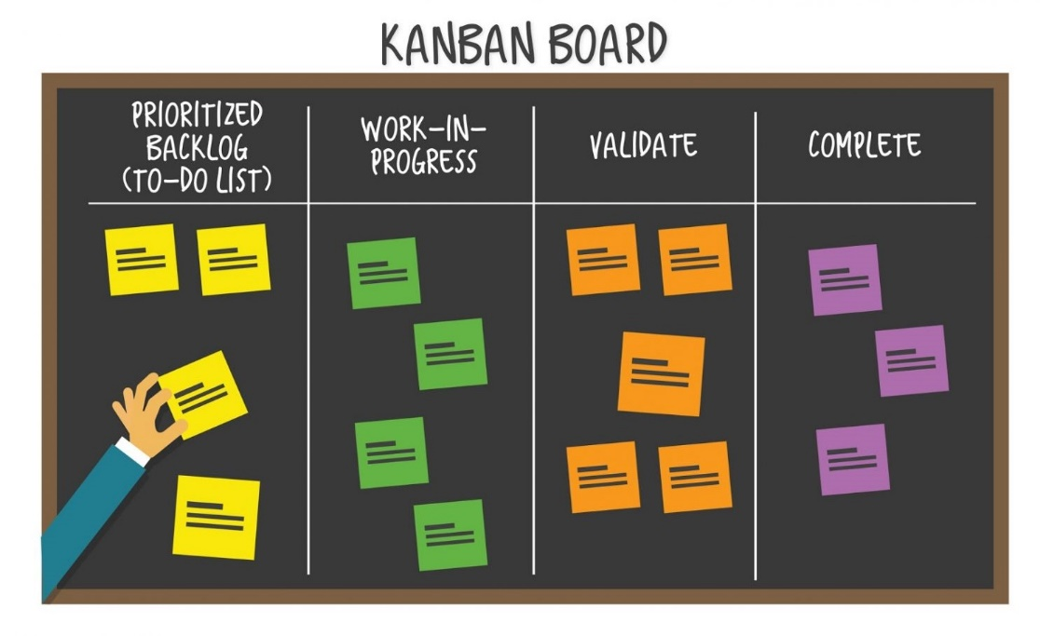
Agile Software Development
Topic: Kanban Framework
Dr. Nikhil Govil
Associate Professor, Program Coordinator – B.Tech. (CSE), Dept. of CEA

Slide 2

Topics To Be Covered
Kanban Board
Kanban Introduction
Kanban Characteristics

Slide 3
Kanban Board

Slide 4
Kanban Board
Agile-Kanban is a popular framework of Agile environment with Kanban approach.
In this, the Kanban board is used to visualize the workflow.
The Kanban board is normally put up on a wall in the project room.
The status and progress of the story development tasks is tracked visually on the Kanban board with flowing Kanban cards.

Slide 5

Kanban Board

Slide 6
Kanban – Introduction

Slide 7
What is Kanban?
Kanban is one of the most popular Agile Framework.
Kanban is a Japanese word that literally means “visual card”.
Kanban cards were originally used in Toyota to limit the amount of inventory tied up in “work in progress” on a manufacturing floor.
Kanban not only reduces excess inventory waste, but also the time spent in producing it.

Slide 8
Kanban Core Concepts
The core concept of Kanban includes:
Visualize Workflow
Split the entire work into defined segments or states, visualized as named columns on a wall.
Write each item on a card and put in a column to indicate where the item is in the workflow.
Limit WIP
Assign explicit limits to how many items can be in progress at each workflow segment / state. i.e., Work in Progress (WIP) is limited in each workflow state.
Measure the Lead Time
Lead Time, also known as cycle time is the average time to complete one item. Measure the Lead Time and optimize the process to make the Lead Time as small and predictable as possible.

Slide 9
Kanban Benefits
Kanban has the following commonly observed benefits –
People collaborate to optimize the whole project rather than just their part(s).
Useful for situations where operations and support teams have a high rate of uncertainty and variability.
Increased visibility of all processes that are going on at the company.
Reduces inventory in the range of 25%-75%, thereby reducing company costs & time. This is termed as eliminating waste.

Slide 10
Kanban – Characteristics

Slide 11
Kanban Characteristics
Kanban has the following characteristics –
Flexibility in Planning
Limits Work in Progress (WIP)
Pull Approach
Minimize Cycle Time
Continuous Delivery
Visual Metrics
Efficiency Through Focus

Slide 12
Flexibility in Planning
Kanban provides improvements in the workflow.
In Kanban, planning is flexible and not time-boxed.
Kanban allows enough time for longer tasks to implement.
Kanban permits continuous flow of the tasks that are completed without wait time.

Slide 13
Limits Work in Progress (WIP)
It allows reducing wait time.
Avoid stress on resources at a workflow state.
Resolve bottlenecks with collaboration of the entire team.
Decreases dependencies in completing a task by splitting it into sub-tasks.

Slide 14
Pull Approach
When we have two teams and the first one is performing better than the second one, it is likely that it pushes more work than the other can actually handle. This is called Pull Approach.
In Pull Approach, the next team pulls work only when it is ready for it.
It reduces wait time.

Slide 15
Minimize Cycle Time
Each task's cycle time is measured and the process is optimized to reduce the cycle times.
The bottlenecks are identified immediately and resolved collaboratively by the entire team.
The correction loops are considered to reduce rework.

Slide 16
Continuous Delivery
Short release cycles result in continuous delivery of growing product at regular intervals.
Continuous interactions with the customer to understand what customer wants & feedback on delivered modules.
Focus is on finishing work rather than on starting work.
Deliver before the customer changes mind.

Slide 17
Visual Metrics
Visually organized workflows (on Kanban Boards) facilitate –
Scheduling as per WIP limits on a workflow state.
Tracking status and progress continually.
Assigning resources dynamically based on the role requirements.

Slide 18
Efficiency Through Focus
By focusing on what a customer wants, the scope becomes clear.
The focus is on delivering value to the customer.
A customer’s expectations can be made realistic and focused with continuous interactions with the customer.
Empowerment of the team makes the team accountable for the success.

Slide 19
References
Ken Schawber & Mike Beedle, Agile Software Development with Scrum, Pearson, 2008.
Robert C. Martin, Agile Software Development, Principles, Patterns and Practices, Prentice Hall,2002.
Lisa Crispin & Janet Gregory, Agile Testing: A Practical Guide for Testers and Agile Teams, Addison Wesley, 2008.
Alistair Cockburn, Agile Software Development: The Cooperative Game, Addison Wesley, 2006.
https://www.tutorialspoint.com/kanban/index.htm/ last accessed on 28/8/2024.

Slide 20


